Slide 1
Rethinking Database Algorithms for Phase Change Memory
Shimin Chen* Phillip B. Gibbons* Suman Nath⁺
*Intel Labs Pittsburgh ⁺Microsoft Research

Slide 2
Introduction
  PCM is an emerging non-volatile memory technology
    Samsung is producing a PCM chip for mobile handsets
    Expected to become a common component in memory/storage hierarchy
  Recent computer architecture and systems studies argue:
    PCM will replace DRAM to be main memory
  PCM-DB project: exploiting PCM for database systems
    This paper: algorithm design on PCM-based main memory

Slide 3
Outline
  Phase Change Memory
  PCM-Friendly Algorithm Design
  B⁺-Tree Index
  Hash Joins
  Related Work
  Conclusion

Slide 4
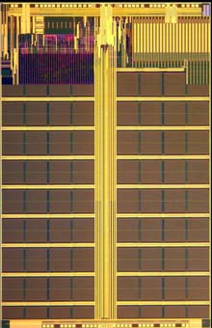
Phase Change Memory (PCM)
  Byte-addressable non-volatile memory
  Two states of phase change material:
    Amorphous: high resistance, representing “0”
    Crystalline: low resistance, representing “1”
  Operations:
“RESET” to Amorphous
e.g., ~610⁰C
Current
(Temperature)
“SET” to Crystalline
e.g., ~350⁰C
READ
Time

Slide 5
Comparison of Technologies
 | DRAM | PCM | NAND Flash
Page size Page read latency Page write latency Write bandwidth Erase latency | 64B 20-50ns 20-50ns ∼GB/s per die N/A | 64B ∼ 50ns ∼ 1 µs 50-100 MB/s per die N/A | 4KB ∼ 25 µs ∼ 500 µs 5-40 MB/s per die ∼ 2 ms
Endurance | ∞ | 10⁶ − 10⁸ | 10⁴ − 10⁵
Read energy Write energy Idle power | 0.8 J/GB 1.2 J/GB ∼100 mW/GB | 1 J/GB 6 J/GB ∼1 mW/GB | 1.5 J/GB [28] 17.5 J/GB [28] 1–10 mW/GB
Density | 1× | 2 − 4× | 4×
  Compared to NAND Flash, PCM is byte-addressable, has orders of magnitude lower latency and higher endurance.
Sources: [Doller’09] [Lee et al. ’09] [Qureshi et al.’09]

Slide 6
Comparison of Technologies
 | DRAM | PCM | NAND Flash
Page size Page read latency Page write latency Write bandwidth Erase latency | 64B 20-50ns 20-50ns ∼GB/s per die N/A | 64B ∼ 50ns ∼ 1 µs 50-100 MB/s per die N/A | 4KB ∼ 25 µs ∼ 500 µs 5-40 MB/s per die ∼ 2 ms
Endurance | ∞ | 10⁶ − 10⁸ | 10⁴ − 10⁵
Read energy Write energy Idle power | 0.8 J/GB 1.2 J/GB ∼100 mW/GB | 1 J/GB 6 J/GB ∼1 mW/GB | 1.5 J/GB [28] 17.5 J/GB [28] 1–10 mW/GB
Density | 1× | 2 − 4× | 4×
  Compared to DRAM, PCM has better density and scalability; PCM has similar read latency but longer write latency
Sources: [Doller’09] [Lee et al. ’09] [Qureshi et al.’09]

Slide 7
Relative Latencies:
Read
DRAM
PCM
NAND Flash
Hard Disk
10ns
100ns
1us
10us
100us
1ms
10ms
DRAM
PCM
NAND Flash
Hard Disk
Write

Slide 8
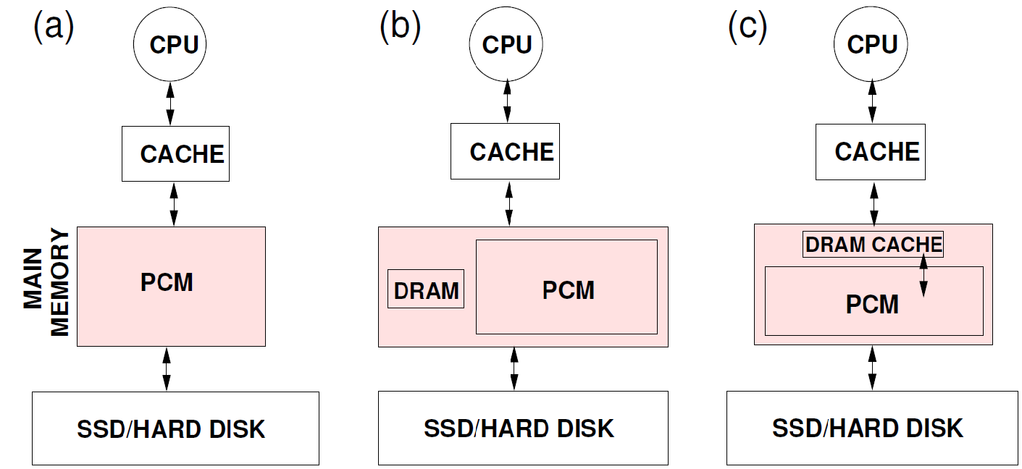
PCM-Based Main Memory Organizations
  PCM is a promising candidate for main memory
    Recent computer architecture and systems studies
  Three alternative proposals:
[Condit et al’09] [Lee et al. ’09] [Qureshi et al.’09]
For algorithm analysis, we focus on PCM main memory, and view optional DRAM as another (transparent/explicit) cache

Slide 9
Challenge: PCM Writes
 | PCM
Page size Page read latency Page write latency Write bandwidth Erase latency | 64B ∼ 50ns ∼ 1 µs 50-100 MB/s per die N/A
Endurance | 10⁶ − 10⁸
Read energy Write energy Idle power | 1 J/GB 6 J/GB ∼1 mW/GB
Density | 2 − 4×
  Limited endurance
    Wear out quickly for hot spots
  High energy consumption
    6-10X more energy than a read
  High latency & low bandwidth
    SET/RESET time > READ time
    PCM chip has limited instantaneous electric current level,
    requires multiple rounds of writes
  Write operation and hardware optimization

Slide 10
PCM Write Operation
[Cho&Lee’09] [Lee et al. ’09] [Yang et al’07] [Zhou et al’09]
  Baseline: several rounds of writes for a cache line
    Which bits in which rounds are hard wired
  Optimization: data comparison write
    Goal: write only modified bits rather than entire cache line
    Approach: read-compare-write
  Skipping rounds with no modified bits
Rounds highlighted w/ different colors
Cache line
0
1
0
1
1
0
0
1
0
1
1
0
0
0
0
1
0
1
0
1
1
0
1
1
0
1
1
0
1
1
1
0
PCM
0
0
1
1
0
0
1
1
1
1
0
0
1
0
0
1
1
0
0
1
1
1
1
0
0
1
0
0
1
0
0
1
0
0
0
1
1

Slide 11
Outline
  Phase Change Memory
  PCM-Friendly Algorithm Design
  B⁺-Tree Index
  Hash Joins
  Related Work
  Conclusion

Slide 12
Algorithm Design Goals
  Algorithm design in main memory
  Prior design goals:
    Low computation complexity
    Good CPU cache performance
    Power efficiency (more recently)
  New goal: minimizing PCM writes
    Improve endurance, save energy, reduce latency
    Unlike flash, PCM word granularity

Slide 13
PCM Metrics
  Algorithm parameters:
    : cache misses (i.e. cache line fetches)
    : cache line write backs
    : words modified
  We propose three analytical metrics
    Total Wear (for Endurance)
    Energy
    Total PCM Access Latency
PCM

Slide 14
B⁺-Tree Index
  Cache-friendly B⁺-Tree:
    Node size: one or a few cache lines large
  Problem: insertion/deletion in sorted nodes
    Incurs many writes!
[Rao&Ross’00] [Chen et al’01] [Hankins et al. ’03]
Insert/delete
num
keys
5
2
4
7
8
9
pointers
Notes:
Sorted nodes are good for binary search , low instruction overhead.

Slide 15
Our Proposal: Unsorted Nodes
keys
  Unsorted node
  Unsorted node with bitmap
  Unsorted leaf nodes, but sorted non-leaf nodes
num
5
8
2
9
4
7
pointers
bitmap
keys
1011
1010
8
2
9
4
7
pointers

Slide 16
Simulation Platform
  Cycle-accurate out-of-order X86-64 simulator: PTLSim
  Extended the simulator with PCM support
  Parameters based on computer architecture papers
    Sensitivity analysis for the parameters
Details of Write Backs in Memory Controller
PTLSim
Data Comparison Writes
PCM
PCM
PCM
PCM

Slide 17
B⁺-Tree Index
Node size 8 cache lines; 50 million entries, 75% full;
Three workloads:
Inserting 500K random keys
deleting 500K random keys
searching 500K random keys
Total wear
Energy
Execution time
Unsorted leaf schemes achieve the best performance
For insert intensive: unsorted-leaf
For insert & delete intensive: unsorted-leaf with bitmap

Slide 18
Simple Hash Join
  Build hash table on smaller (build) relation
  Probe hash table using larger (probe) relation
  Problem: too many cache misses
    Build + hash table >> CPU cache
    Record size is small
Build Relation
Probe Relation
Hash Table

Slide 19
Cache Partitioning
[Shatdal et al.’94] [Boncz et al.’99] [Chen et al. ’04]
  Partition both tables into cache-sized partitions
  Join each pair of partitions
  Problem: too many writes in partition phase!

Slide 20
Our Proposal: Virtual Partitioning
  Virtual partitioning:
  Join a pair of virtual partitions:
  Preserve good CPU cache performance while
  reducing writes
Compressed Record ID Lists
Build Relation
Probe Relation
Hash Table

Slide 21
Hash Joins
50MB joins 100MB;
varying record size from 20B to 100B.
Total wear
Energy
Execution time
Virtual partitioning achieves the best performance
Interestingly, cache partitioning is the worst in many cases

Slide 22
Related Work
  PCM Architecture
    Hardware design issues: endurance, write latency, error correction, etc.
    Our focus: PCM friendly algorithm design
  Byte-Addressable NVM-Based
  File Systems
  Battery-Backed DRAM
  Main Memory Database Systems
  & Cache Friendly Algorithms
Not considering read/write asymmetry of PCM

Slide 23
Conclusion
  PCM is a promising non-volatile memory technology
    Expected to replace DRAM to be future main memory
  Algorithm design on PCM-based main memory
    New goal: minimize PCM writes
    Three analytical metrics
    PCM-friendly B⁺-tree and hash joins
  Experimental results show significant improvements

Slide 24
Thank you!
shimin.chen@intel.com

