Slide 1
Answering Queries using Humans, Algorithms & Databases
Aditya Parameswaran
Stanford University
(Joint work with Alkis Polyzotis, UC Santa Cruz)
1/11/11

Slide 2
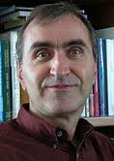
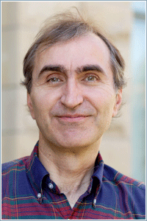
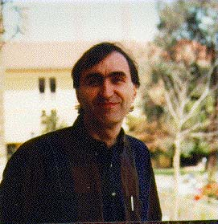
Why Crowd-source?
Many tasks are done better by humans
  Understanding speech, images and language
Many people are online and willing to work
Several commercial marketplaces
  Amazon’s Mechanical Turk, Odesk, LiveOps, …
Several programming libraries
  TurKit, HPROC, …
Label/Tag
Identify
Description
Compare
Sort
Rank

Slide 3
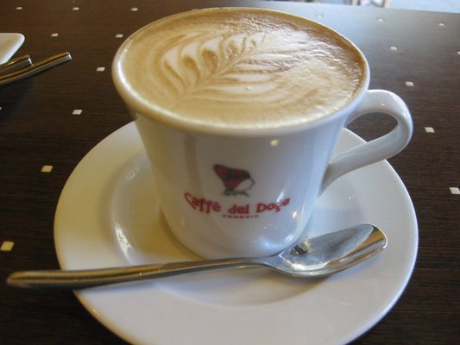

Example
Select top-k images for a restaurant from a user-submitted image DB
  Must display food served in restaurant OR
  Must display restaurant name
  Not dark
  Not copyrighted
Need to ask humans
Can use image processing algorithms for some cases
Can look up database containing meta-data

Slide 4
Example: Current Solution
Programmer does all the work
Implements calls to:
  Crowd libraries, hand-coding:
    Which tasks to run
    On which items
    In what order
    For what price
  Algorithms, since crowd latency may be high, specifying:
    For which tasks, on which items and in what order
  Relational data
  Write code to :
  Integrate obtained information
  Deal with inconsistencies and incorrect answers from the crowd

Slide 5
Our Vision
Declarative Query Processing Engine
Query
Result
Data
Humans
Algorithms
Nothing out-of-the-ordinary for DB people!
Application only provides the UI to ask questions to humans
Remainder handled “under the covers” by the query optimizer
Application development becomes much simpler.

Slide 6
Outline for the Talk
Declarative Query Processing Engine
Query
Result
Data
Humans
Algorithms
Example Declarative Queries
Need for Redesign
Research Challenges + Initial ideas
  Query Semantics
  Physical Query Processing
  Handling Uncertainty
  Other Important Issues

Slide 7
Example Query
Find all jpg travel pictures: either large pictures of a clean beach, or pictures of a clean and safe city
4 types of predicates
  r – relational predicates
  a – algorithmic predicates
  h – human predicates
    UI for question is provided by the application.
  ha – mixed (human / algorithmic) predicates
    Can ask humans or can use algorithms
travel(I):= rJpeg(I), hClean(I), hBeach(I), aLarge(I)
travel(I):= rJpeg(I), hClean(I), haCity(I,C), rSafe(C)
Is this an image of a clean location?

Slide 8
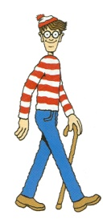
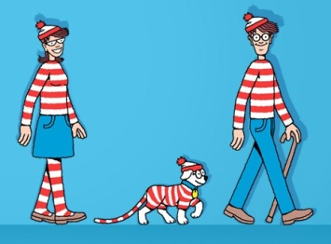
Other Examples
Find all images of people at the scene of the crime who also have a criminal record
  suspects(N, I):=rCriminal(N, P), rScene(I), haSim(I,P)
  rCriminal : database of known criminals, with images
  haSim : evaluates presence of P in I
Then the results may be used for an aggregation: Find the best image for every criminal
  topImg(N, hBest(<I>)):= suspects(N, I)
  hBest : the top image
Do these images contain the same person?

Slide 9
Need for a New Architecture
uncertainty
Tradeoffs between
  Performance,
  Monetary cost, and
  Uncertainty in query result
Unknown
  Selectivities
  Latency for both algorithms and humans
  Uncertainty in answers
This combination of “evils” has never appeared before!
Plus, some other aspects that will become clear later
Uncertain databases
time
cost
Adaptive Query Optimization
User Defined Functions

Slide 10
Semantics of Query Model
uncertainty
We want “correct answers”
  What is a correct answer?
  Notion not clear:
    Correlations and Inconsistencies
    Mistakes and Lack of knowledge
  We use a threshold on confidence to define correctness (later)
Three semantics:
  Find all correct answers, minimizing cost and time
  Find k correct answers, minimizing cost and time
  Find as many as possible, and minimize time for fixed cost
time
cost

Slide 11
Query Proc. without Uncertainty
travel(I):= rJpeg(I), hClean(I), hBeach(I), aLarge(I)
travel(I):= rJpeg(I), hClean(I), haCity(I,C), rSafe(C)
Two-criteria optimization , e.g., cost & time
Selectivities are not known
  Adaptive query optimization
Latency not known
  Asynchronous execution
It is critical to reason about the Information gain of a question

Slide 12
Asking the right questions
travel(I):= rJpeg(I), hClean(I), hBeach(I), aLarge(I)
travel(I):= rJpeg(I), hClean(I), haCity(I,C), rSafe(C)
Prefer questions affecting more tuples “downstream”
If all correct answers needed :
  Prefer selective questions
If k correct answers needed :
  Prefer non-selective questions leading to answers
For complex tasks
  Need to subdivide into questions that maximize information gain
    e.g., Classify, Cluster, Categorize
  We studied this problem carefully for graph search
  Human-assisted graph search: It’s okay to ask questions, VLDB ‘11

Slide 13
Query Proc. without Uncertainty
Intra and inter-stage optimization
Stage 1
Stage 2
Perform computations on relational data
Issue a set of asynchronous questions to
Crowd
Algorithms
Collect results from previous stages
Prefer algorithmic and relational questions
Stage 3
……
Stage n

Slide 14
Uncertainty
Sources:
  Intra-predicate correlation
  Inter-predicate correlation
  Subjective views, random mistakes
  Lack of knowledge
Only want correct answers (confidence > τ)
Standard techniques are insufficient!
travel(I):= rJpeg(I), hClean(I), hBeach(I), aLarge(I)
travel(I):= rJpeg(I), hClean(I), haCity(I,C), rSafe(C)
answers to two images I for hClean
answer to I for hBeach is YES → NO for haCity

Slide 15
How do we compute confidence?
Scheme 1: Majority voting
  Each question attempted by c humans
  Majority answer taken as the correct answer
Scheme 2: Homogeneous worker population
  Per question, each worker is IID from a distribution
  No cross-correlations
  Infer distribution based on answers of workers
Scheme 3: Item Response Theory

Slide 16
Other Important Aspects
Pricing
  Must price tasks so that they complete
  “Important”, “harder” tasks priced higher
Spam
  Test questions or a Gold standard
  Reputation systems for workers
Choosing UI questions for predicates

Slide 17
From Tasks to UI Questions
suspects(N, I):= rCriminal(N, P), rScene(I), haSim(I,P)
  topImg(N, hBest(<I>)):= suspects(N, I)
The choice of the UI affects:
  The number of UI questions (thus, the cost)
  The overall uncertainty of the answer
  Latency
Complex tasks:
  Sort, Top-k, Max
Compare
Sort
Are the two images alike?
Match similar images from the two sets
I₁
I₂
I₃
I₁
I₂
I₁
I₂
I₃
J₁
J₂
J₃
I₁
J₁

Slide 18
Conclusions
Using human computation within the database
  Important and challenging new research area for DB people
  Requires a careful redesign of the DBMS
  More parameters/tradeoff that we need to keep track of
Vision of the sCOOP project
  (System for COmputing with and Optimizing People)
Look out for our paper at VLDB in Seattle!
  Human-assisted Graph Seach: It’s okay to ask questions!
    By: A. Parameswaran, A. Das Sarma, H. Garcia-Molina,
    N. Polyzotis and J. Widom

